Slide 1

SB Weather boys
Nathaniel Hedman - N01112536
Robert Miller - N01364182
Jeremy Persaud – N01338636
Gagandeep Saini – N01364182

Slide 2
introduction
Our app SB Weather was designed to work with our hardware project in CENG 317
Read Temperature, Humidity, Air Pressure and Wind Speed data recorded from their respective sensors and output the data into a database and then display the values within the app
Chose this project because it can help amateurs get into meteorology and give home owners an idea about the climate in their area

Slide 3
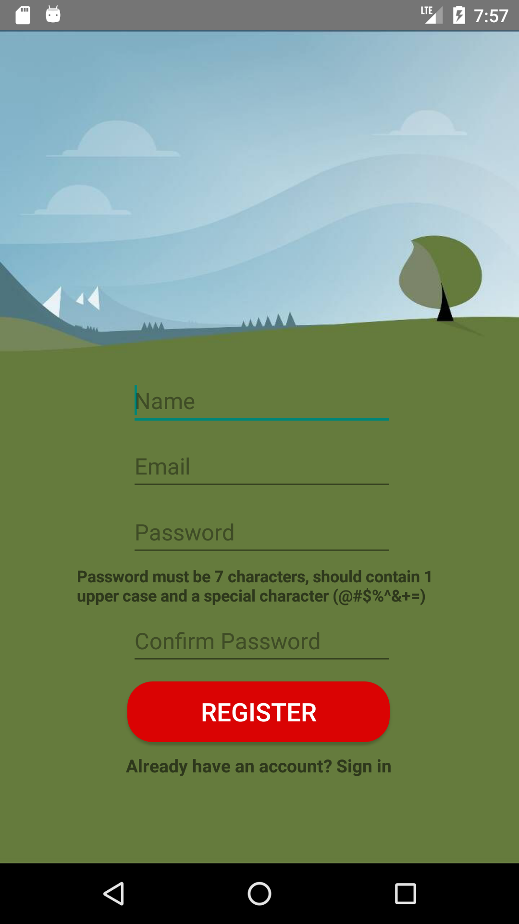
Register
Include name, email, password and then retype password for confirmation
Password should be at least 7 characters and contain a special character(@#%&+=)

Slide 4
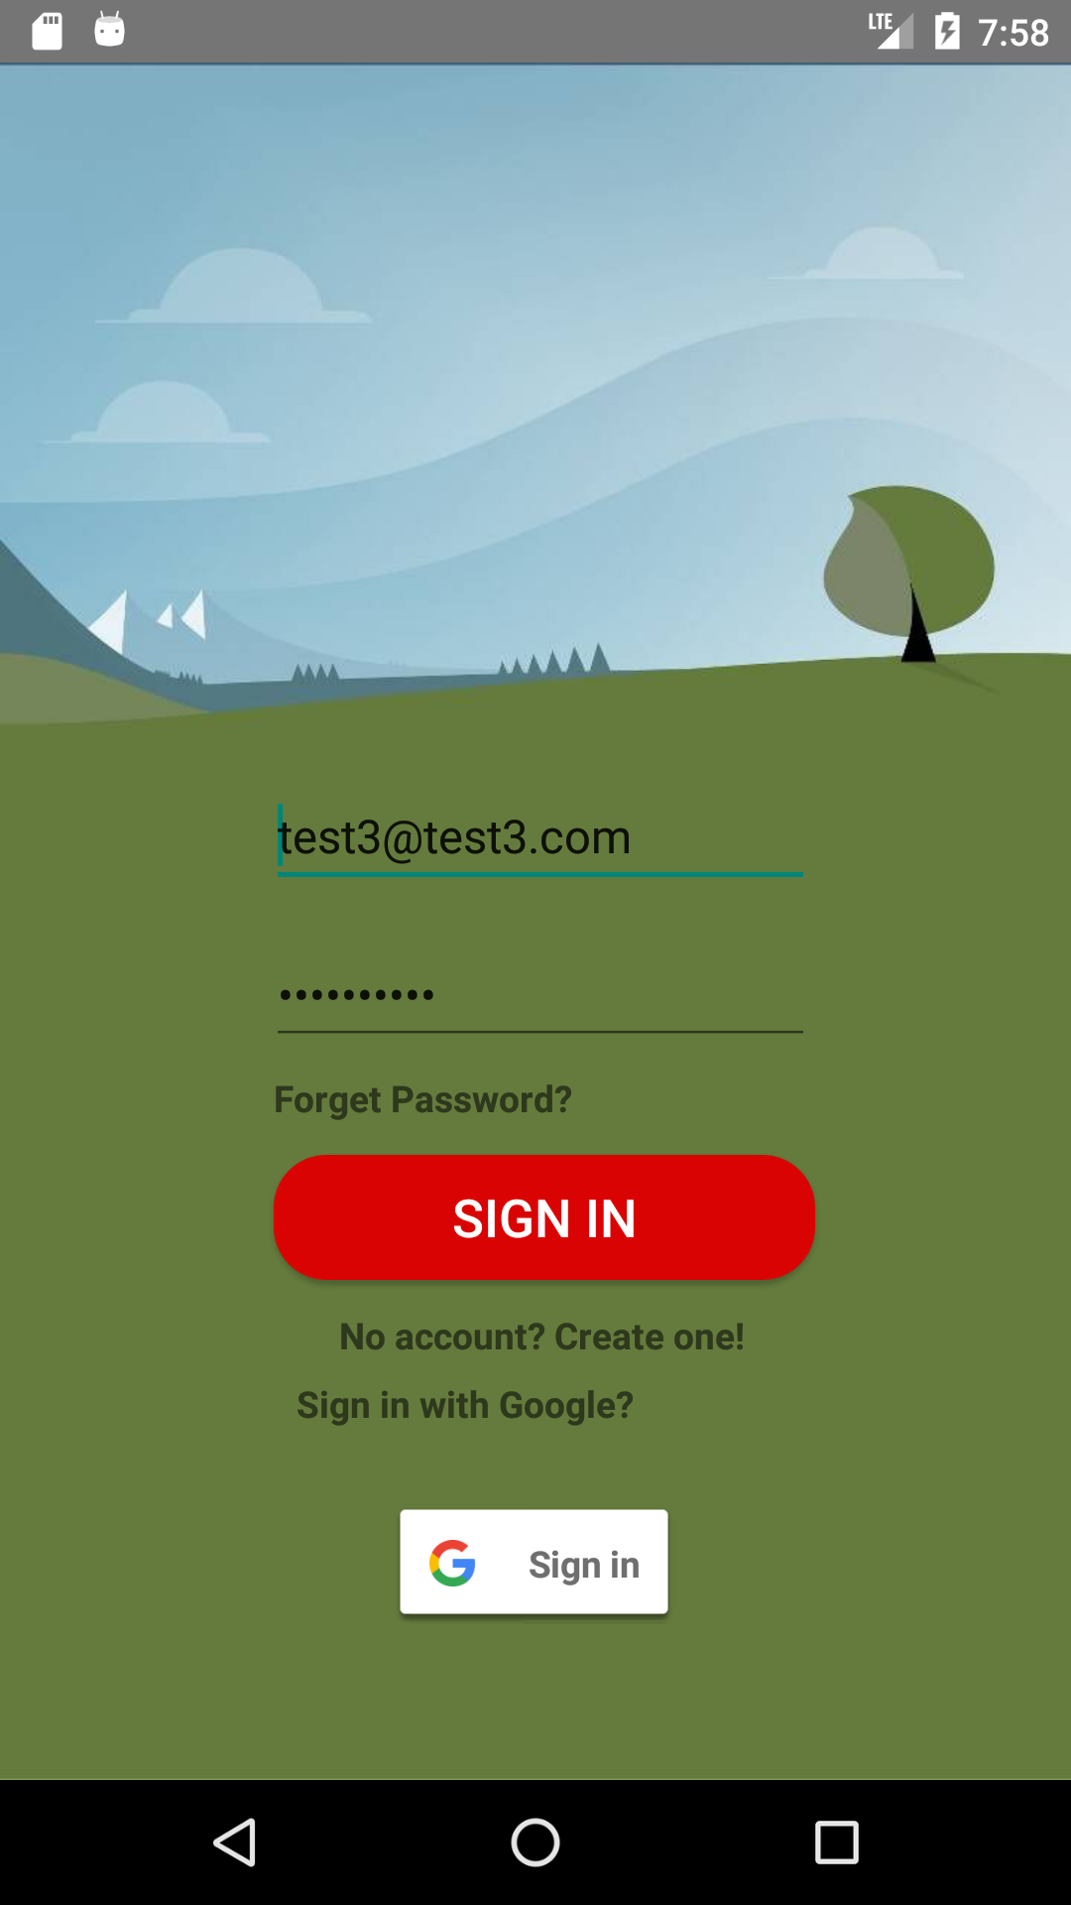
Login
Email and password are then stored in sharedpreferences so that user does not have to remember login information

Slide 5
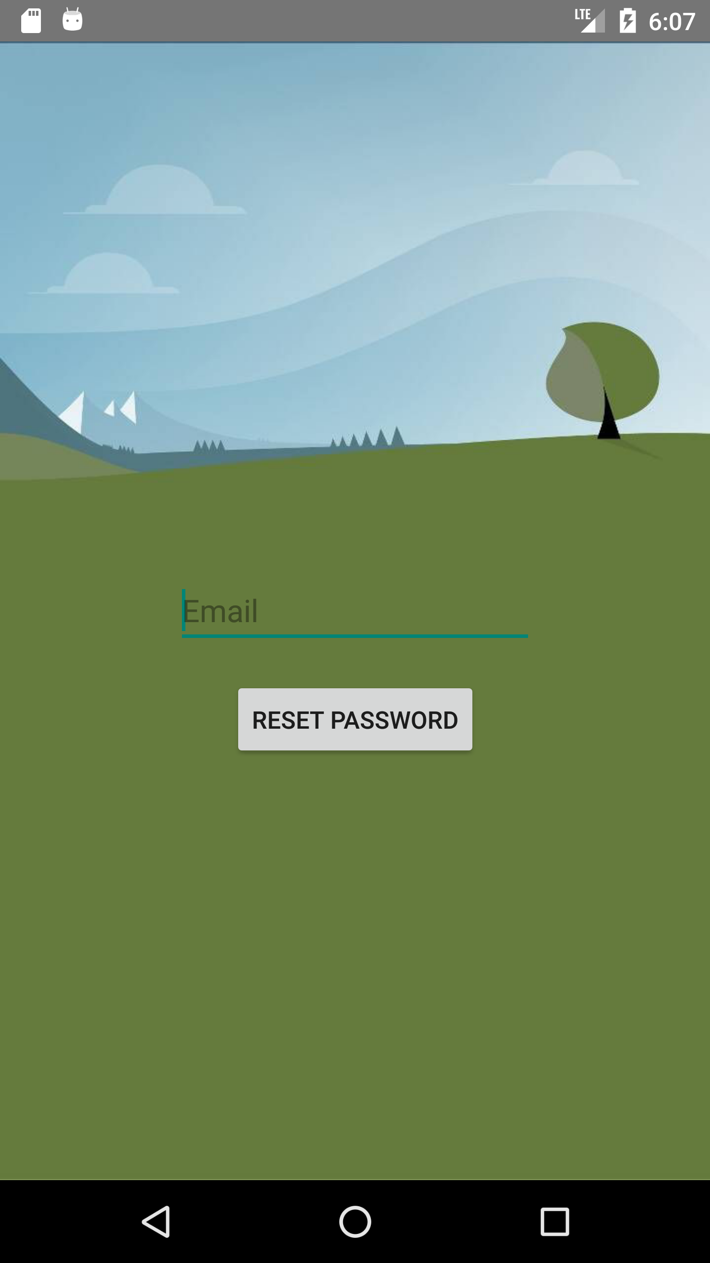
FORGET PASSWORD
If user wants to reset their password they include the email they made the account with and then they will be sent a link with instructions to reset their password

Slide 6
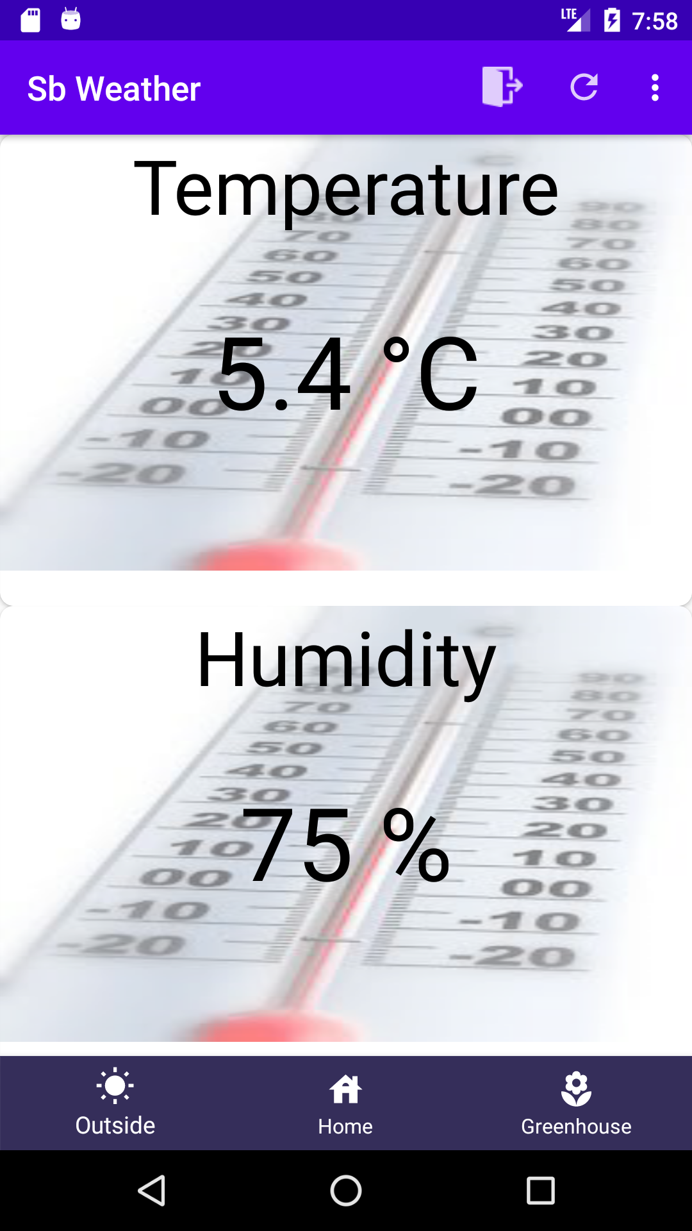
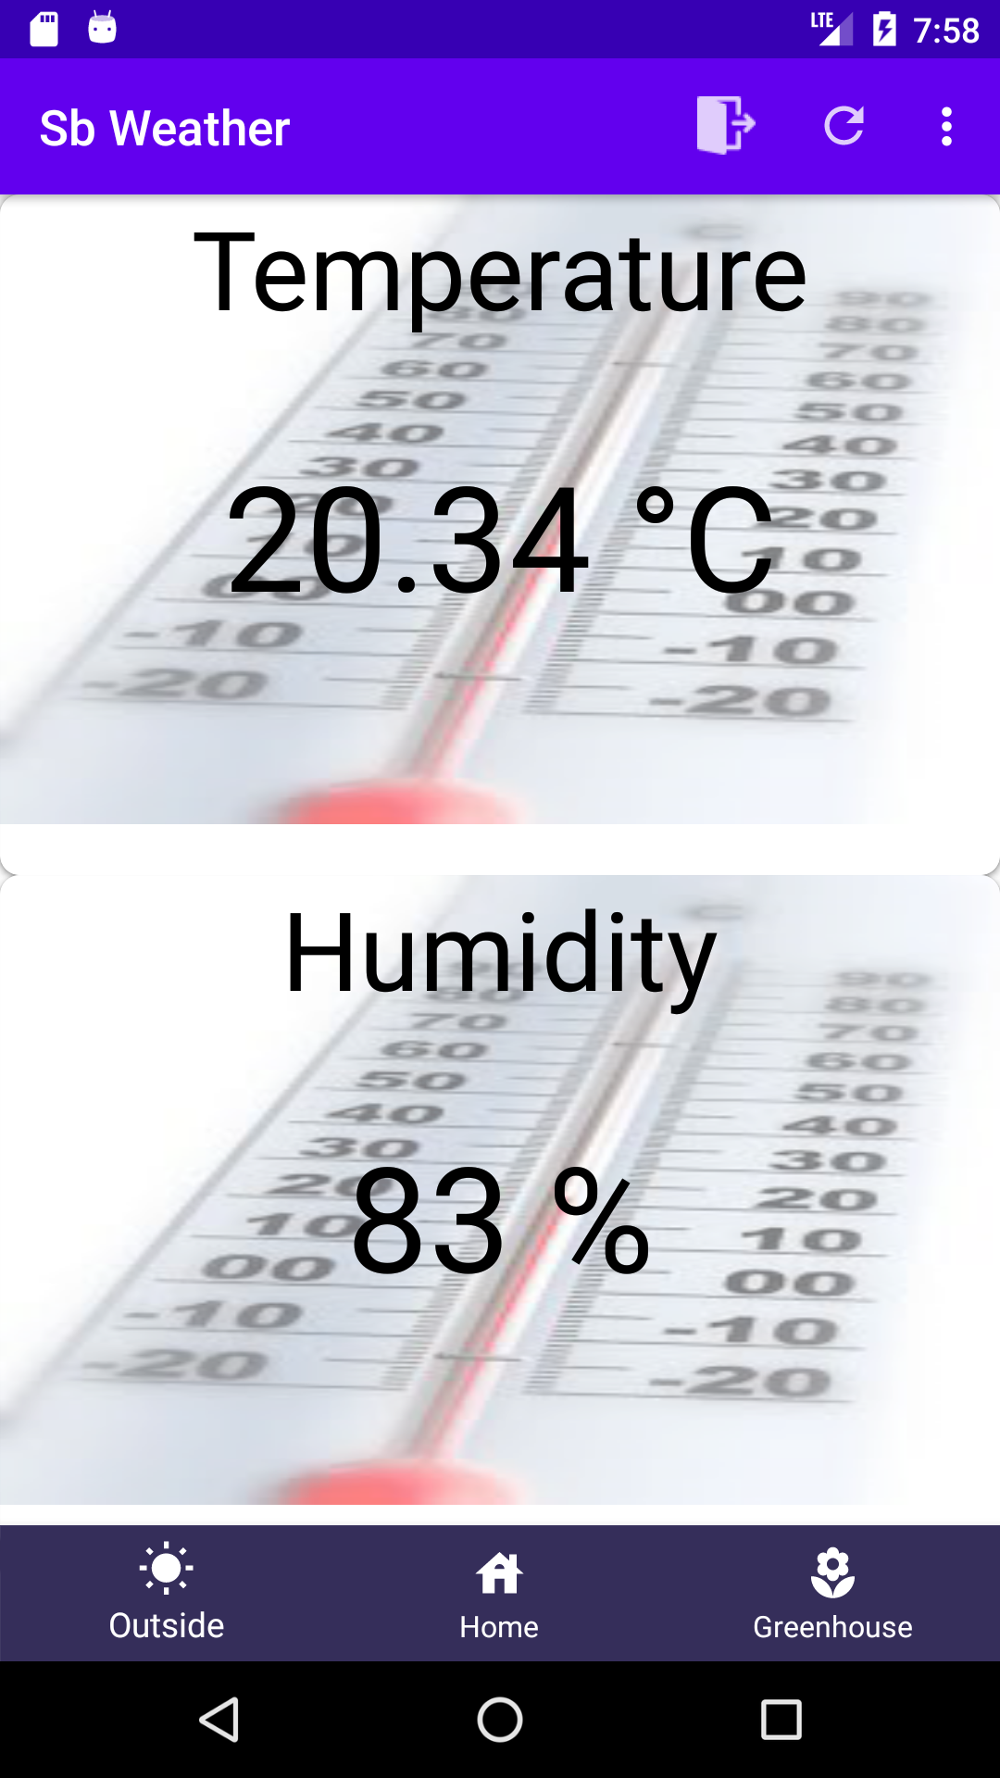
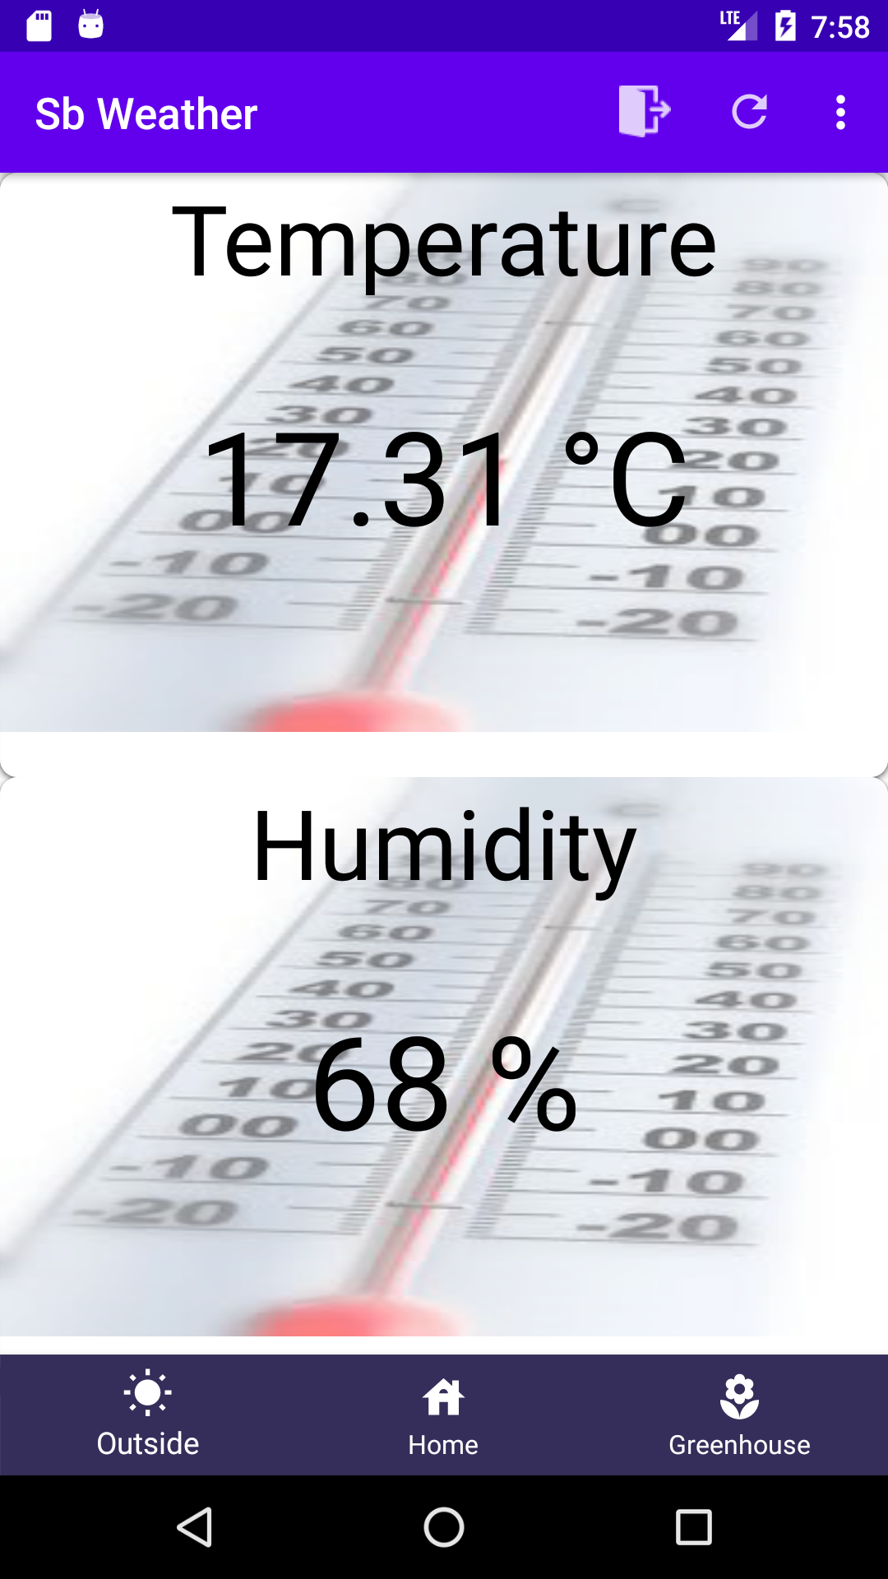
Home
Home page contains a card view with a recyclerview for scrolling which contains the live data from our sensors
Data being obtained from openweatherMap for now but later will be obtained from our hardware project sensors in semester 6
Reads data from up to three weather stations

Slide 7
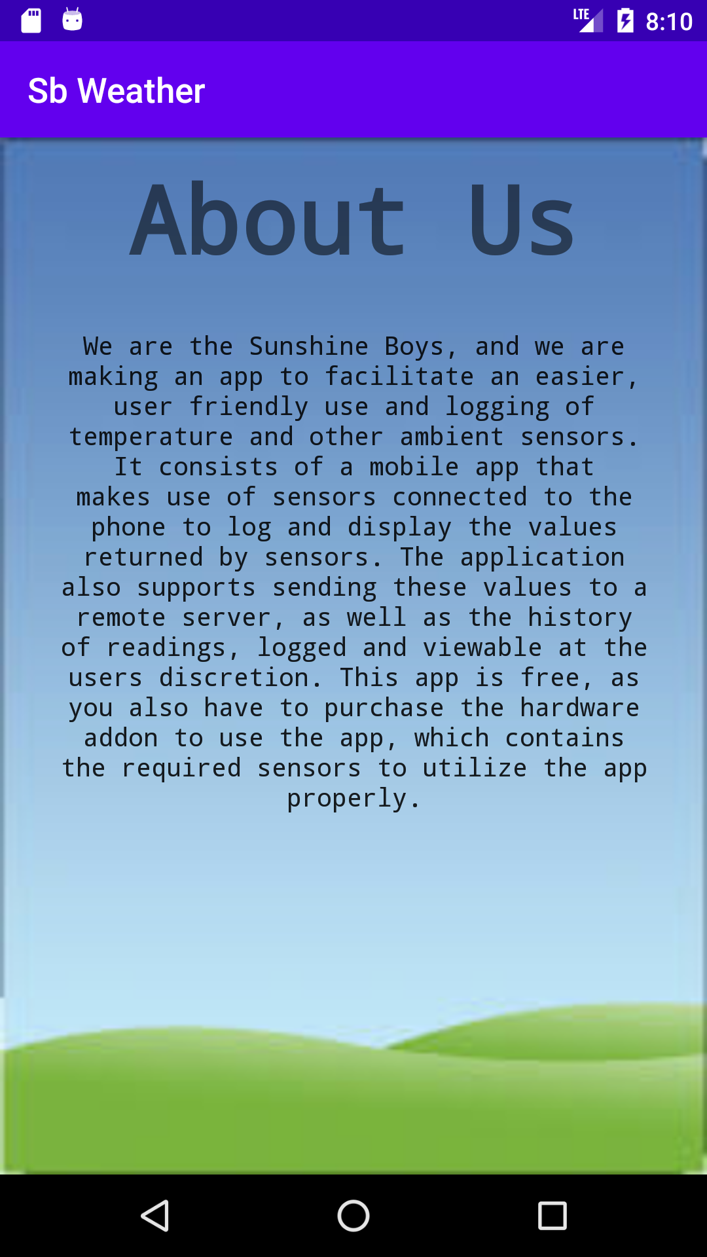
ABOUT US
The about us page gives insight to what our project is about and how to use our app properly with the hardware

Slide 8
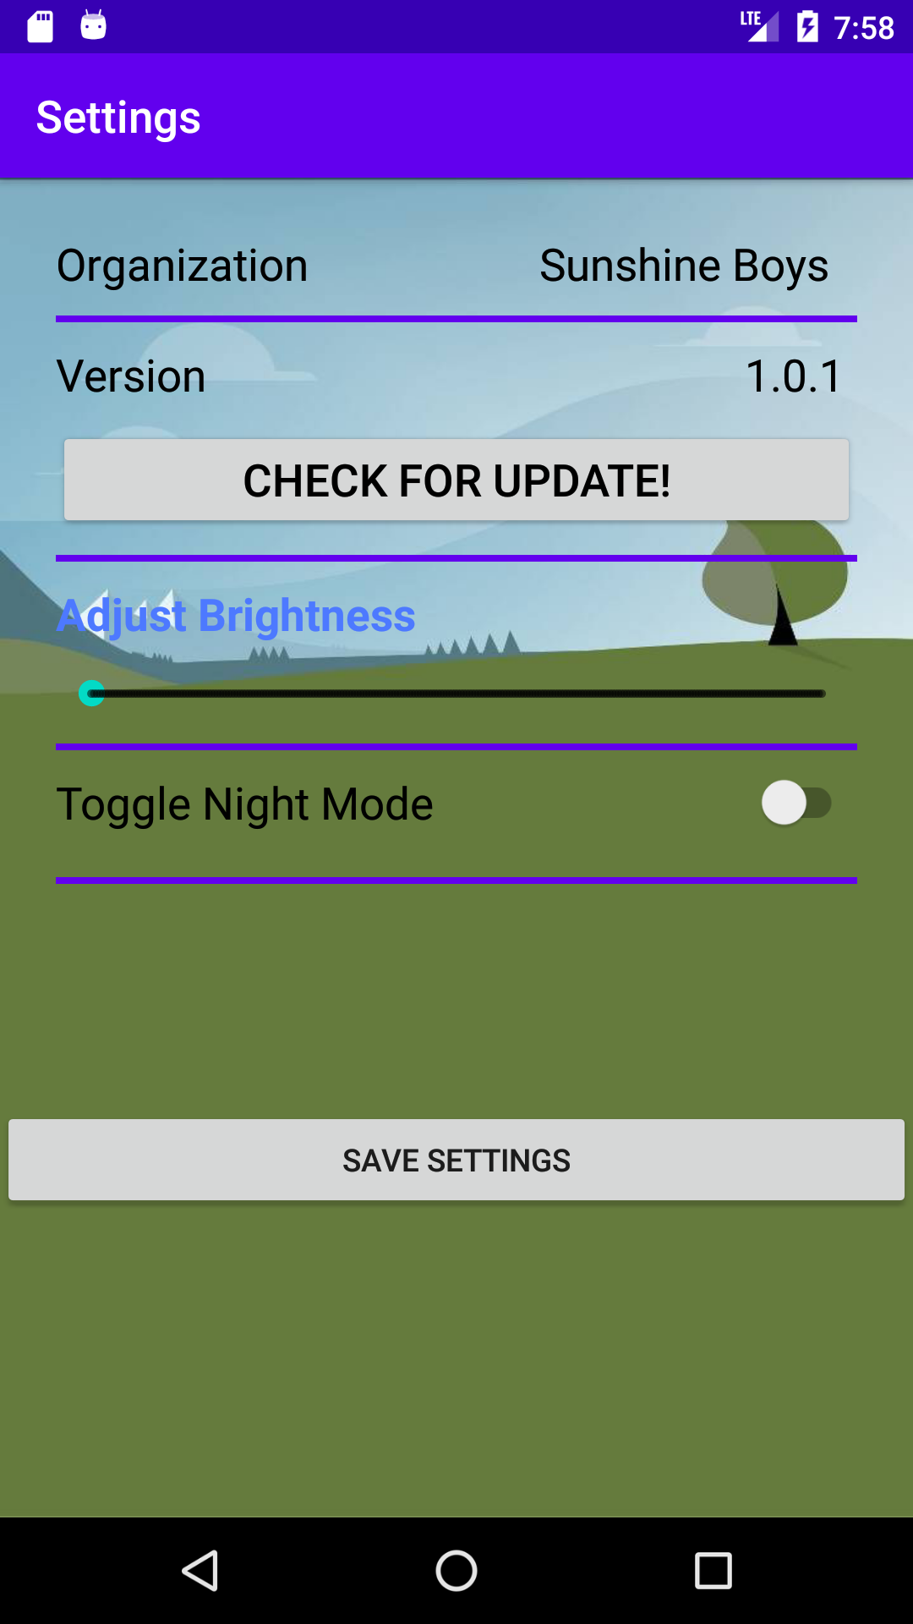
Settings
Settings page contains organization, and version information
You can also check for the latest update, adjust brightness settings (after you give permission to do so on device) and enable night mode

Slide 9
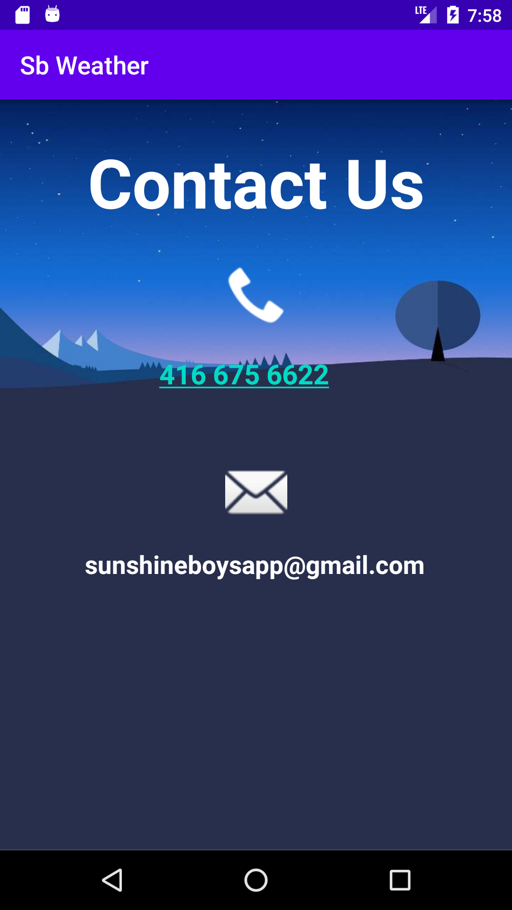
CoNTACT US page
Contact Us page for our users to reference if they need support or more information about our app

Slide 10
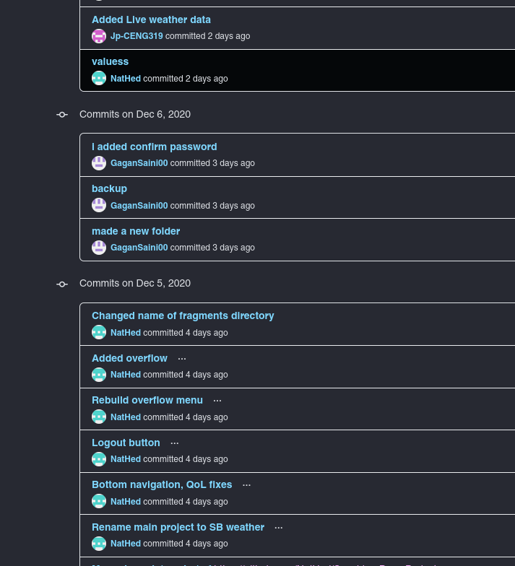
GITHUB

Slide 11
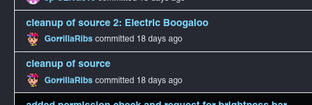
GITHUB II

Slide 12
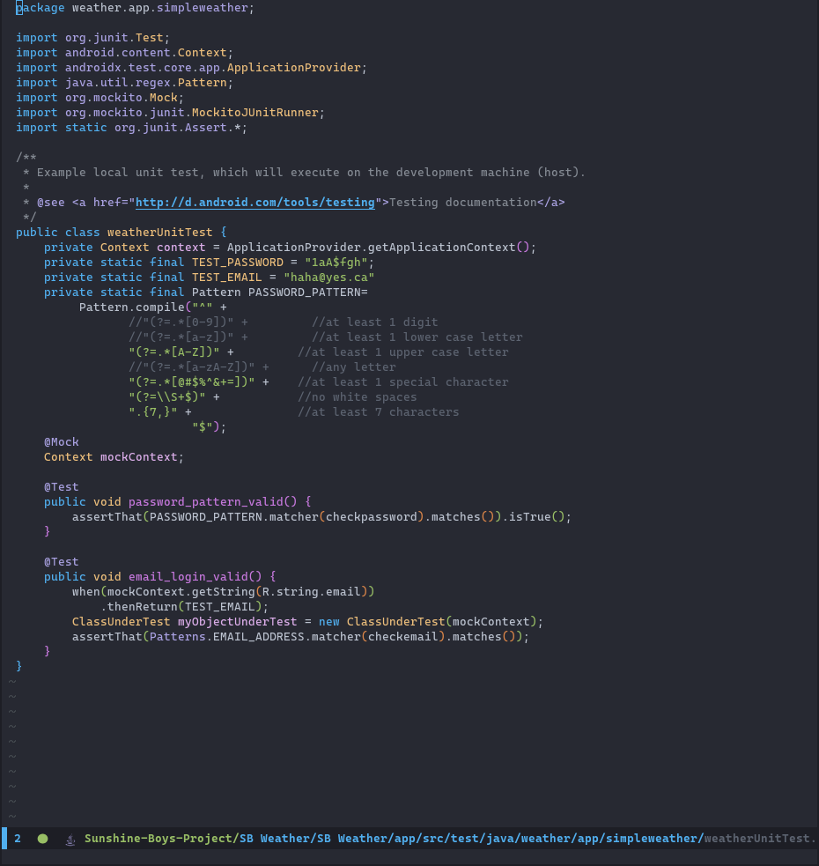
Unit Tests

